Slide 1

Chapter 6: Compiling to the Assembly Level Part 1 (Sections 6.1-6.3)
Notes:
This lecture will review the information from Sections 6.1 thru 6.3 in the textbook.

Slide 2
Objectives
Show relationship between high-order languages and assembly language
Show how a compiler might translate the C++ code
Learn new assembly language techniques
Assembly language programs shown will mimic the C++ programs
Thus the programs are not the most efficient implementations!
Notes:
We will look at how the compiler might translate C++ into Assembly language.
We will also see that if the compiler follows general rules it will not create the most efficient implementation.

Slide 3
Objectives
Differences between high-level languages and assembly languages:
Assembly has no data types
Assembly has only branch statements, no decision or flow control statements like if and while
Notes:
We have frequently discussed that there are no data types at the assembly & machine code levels.
We will see that Assembly only has branch statements, no decision of flow control.

Slide 4
6.1 Local Variables & Stack Addressing
Learning Objectives:
Use Stack-relative Addressing Mode to push and pop local variables
Compare and contrast the declaration and accessing of three kinds of variables:
Global variables
Local variables
Constants
Notes:
We will learn how to use the stack to store local variables and see the difference between storage for global & local variables and constants.

Slide 5
Local Variables & Stack Addressing
Recall Ch. 2 variables & memory:
Global variables stored in program memory Local variables stored on stack
Run-Time Stack
Memory usage varies during execution
For local variables
For procedure/function calls
Notes:
Remember global variables are stored in program memory and local variables are stored on the stack.
Also variables for procedure and function calls are stored on the stack.
The Pep8 simulator will show this graphically and it should become very clear.

Slide 6
Stack Relative Addressing
Stack Relative Addressing allows programs to put data on the run-time stack
Program calling a subroutine must push parameters onto the stack
Subroutine must push local variables onto the stack
Notes:
We will introduce and use a new addressing mode – Stack Relative Addressing.
This allows programs & subroutines to push parameters and variables onto the stack and address them relative to the stack pointer.

Slide 7
Hardware: Stack Organization & Pointer
Last in, First out
Stack Pointer Register (SP) contains the address of the last item
Loader initializes SP Mem[FFF8]=FBCE
As stack grows address decreases
Notes:
The stack is organized in a last in, first out LIFO method.
The CPU register for the stack pointer always contains the address of the last item pushed on the stack.

Slide 8
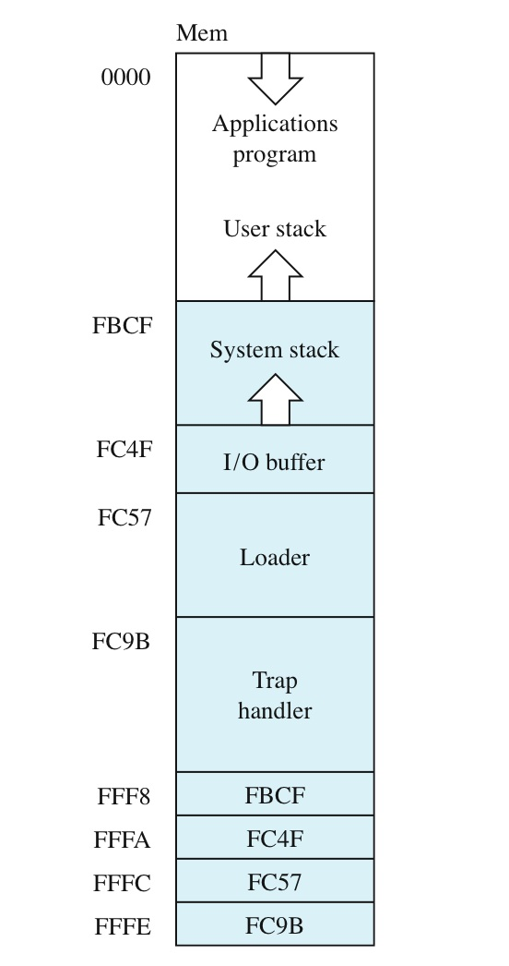
Run-time stack in Pep/8
FBCF is the initial top of the user stack
Notes:
When the program is loaded in memory, the loader initializes the stack pointer register to FBCF.
As data, which can be return values, variables or return addresses, is pushed on the stack the stack pointer is decreased and it grows upward in the memory area.

Slide 9
Stack Relative Addressing
Stack-Relative Addressing:
Oprnd = Mem[SP + OprndSpec]
Stack pointer acts as a memory address to which the operand specifier is added
Operand specifier is the offset from the top of the stack
Notes:
For stack relative addressing the memory address for the operand is determined by adding the stack pointer to the operand specifier, which is an offset from the top of the stack.

Slide 10
Stack Relative Addressing
Operand specifier is the offset from the top of the stack
If the operand specifier is 0, the instruction accesses the top of the stack.
If the operand specifier is 2, it accesses Mem[SP+2], the value two bytes below the top of the stack.
If the operand specifier is -2, it accesses Mem[SP-2], the value two bytes above the top of the stack.
Notes:
Let’s look at some examples of that:
When the operand specifier is 0 - the instruction will access the value at the top of the stack.
When the operand specifier is 2 – the instruction will access the value 2 bytes below the top.
When the operand specifier is -2 – the instruction will access the value 2 bytes above the top.

Slide 11
Stack Relative Addressing
ADDSP and SUBSP manipulate the stack pointer directly
Must use immediate addressing mode with these instructions
ADDSP adds a value to the stack pointer
SUBSP subtracts a value from the stack pointer
Run-Time stack grows toward low addresses
To allocate storage on the stack, subtract a value with SUBSP
To deallocate storage, you add a value with ADDSP
Notes:
Two instructions, ADDSP and SUBSP are used to manipulate the stack point directly. They must be used with immediate addressing mode.
ADDSP adds a value to the stack pointer & SUBSP subtracts a value from the stack pointer.
Remember the run-time stack grows toward lower addresses – you must think in reverse.
Therefore to allocate storage on the stack, subtract a value with SUBSP
And to deallocate storage, you add a value with ADDSP.

Slide 12
Stack Relative Addressing
CALL, RETn, and RETTR manipulate the stack pointer indirectly
Note: There is no way to set the stack pointer by loading a value into it
There is no LDSP instruction
Notes:
CALL, RETn, and RETTR manipulate the stack pointer indirectly when subroutines are called or returned from a stack frame is added or removed.
Note: There is no way to set the stack pointer by loading a value into it
There is no LDSP instruction.

Slide 13
Stack Relative Addressing
The SP is initialized automatically when a program is executed
SP ← Mem[FFF8]
PC ← 0000
Mem[FFF8] is located in Pep/8 ROM
contains the value FBCF, the bottom of the user stack.
Can only be changed by burning ROM
Notes:
The SP is initialized automatically when a program is executed.
When you step through a program you will see the stack pointer and the program counter initiated on the first step.
SP ← Mem[FFF8]
PC ← 0000
Memory location [FFF8] is located in Pep/8 ROM which contains the value FBCF, the bottom of the run-time stack.
It can only be changed by burning ROM

Slide 14
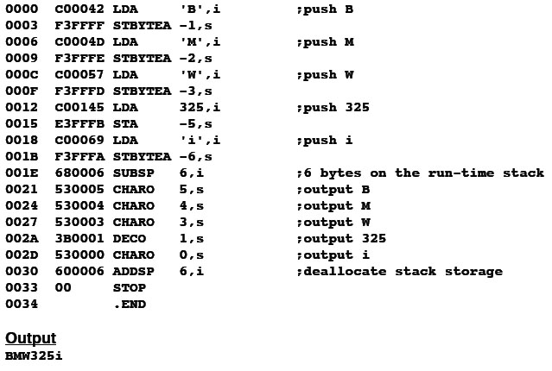
Stack-relative addressing
i
325
325
W
W
W
e
M
M
M
B
r
B
B
B
7BE6
7BE6
7BE6
7BE6
7BE6
FBCF
FBC9
Notes:
Let’s step through an example:
The accumulator is loaded with the letter B
<click>
The next command is storing a byte in the accumulator into memory.
The memory location is determined by subtracting 1 from the stack pointer.
You see the letter B is stored at BFC8
<click>
<click>
This is repeated for M and W – each only needing 1 byte of storage.
Then the number 325 is loaded into the accumulator.
<click>
Note it needs two bytes of storage so the memory location must be determined by subtracting 2 from the stack pointer.
<click>
Then i is loaded – again only needing 1 byte of memory.
<click>
Finally, 6 is subtracted from the stack pointer to reset it to the top.
After the character & decimal information loaded is output and 6 is added to the stack pointer to move it back to the beginning.
There is a lot of maintenance involved with the stack pointer.
However, many of you have been taught to use local variables because the stack reliably frees up memory space when it is no longer needed.
Global variables in main memory tend to be more persistent even when they are not being used.

Slide 15
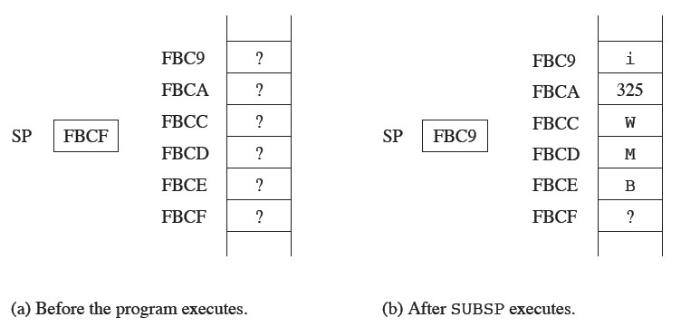
Pushing “real” onto the stack in Program 6.8
Notes:
Here is a diagram of the PEP8 stack by memory location.

Slide 16
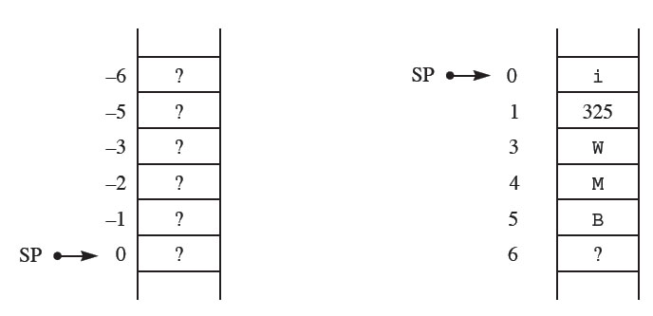
A simplified diagram of the stack in Program 6.8
Notes:
Here is a diagram of the PEP8 stack showing the values for stack relative addressing and showing the stack pointer after the SUPSP instruction.

Slide 17
Good/Bad of Stack Relative Addressing
Good
Don’t need/care about absolute address
Only use what you need
Bad
Risk of unequal pushing/popping
Notes:
The good side of stack relative addressing is that you don’t need to determine absolute address and that you only use what you need.
The risk is that you will have unequal pushing & popping.

Slide 18
Translating HOL Local Variables
What does the compiler and/or machine need to know?
Location of items on the stack
Sometimes we want items that aren’t on top
Offset depends on data type and quantity
When to move the stack pointer up/down
Notes:
So when translating from C++ the compiler needs tell the machine the location of the items on the stack and when to add or subtract from the stack pointer.

Slide 19
Local Variables
Local variables are stored on the run-time stack
Method:
Allocate local variables with SUBSP
Access local variables with stack-relative addressing
Deallocate storage with ADDSP when function is finished.
Notes:
So how do we store local variables on the stack?
First allocate storage space for the local variables with SUBSP.
Then access the variables with stack relative addressing.
Finally deallocate the storage space when the function is completed
Let’s see how this is done.

Slide 20
Local Variables
Global variables
.BLOCK command inserts bits in the assembly process
Storage is reserved in RAM before program executes. Is part of the program
Location is fixed for duration of program
Local Variables
SUBSP is an executable statement
Space created at run time on run-time stack
Notes:
First remember in Chapter 5 – Global variables were reserved storage with the .BLOCK command before the program was executed.
Local variables will not have storage space until the program is run.

Slide 21
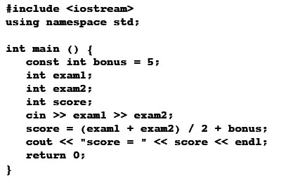
Local Variables
Same as program 5.26 except variables are declared local to main( )
Bonus is constant
Variables are local
Notes:
This program is the same as the one in Chapter 5 except the variables have been declared as local variables inside the main.
<click>
Bonus is a constant
<click>
And exam1, exam2 and score are local variables.
In C++, these two programs execute exactly the same.

Slide 22
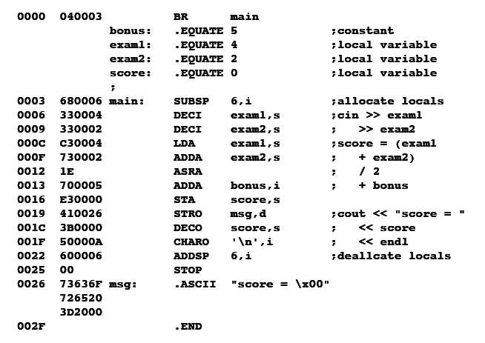
Local Variables
Bonus is constant
Set constants for use in program
Create space on stack for locals
use constants with stack
relative addressing
Notes:
When they are translated to Assembly, the variables are treated differently.
<click>
Bonus is set up as a constant.
<click>
Here the .EQUATE command is used to determine the stack pointer offset needed for each variable.
These offsets are constants like bonus is.
<click>
6 is subtracted from the stack pointer to create space on the stack
<click>
The offset constants are used to point to the variables with stack relative addressing.

Slide 23
Local Variables
.EQUATE
For bonus creates a constant
For other variables provides the distance from top of stack
Does not create space on the stack!
SUBSP
Provides the space for the local variables on the stack
Local variables accessed with stack relative addressing
Notes:
So .EQUATE is used to capture the variable location as a distance from the top of the stack.
SUBSP creates the space on the stack
The variables are accessed with stack relative addressing

Slide 24
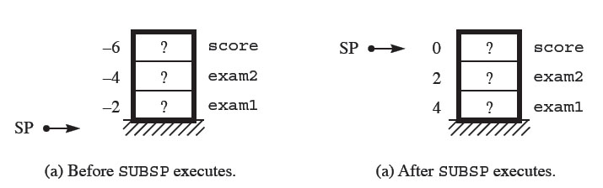
Local Variables
Note that there are no values on the stack yet.
Notes:
This diagram shows that the space is allocated before the values are actually assigned.

Slide 25
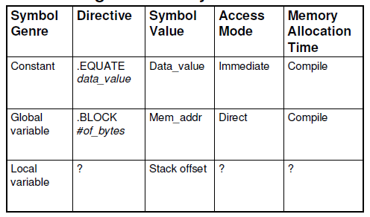
Translating Different Symbols
Quick summary:
.EQUATE
Stack offset
Stack relative
Run-time
Notes:
Let’s see if you can finish this chart.
The directive to establish a local variable is?
<click>
.EQUATE with a value for the stack offset
The addressing mode to access the local variable is?
<click>
Stack relative
The memory allocation for the local variable happens at?
<run-time>

Slide 26
6.2 Branching and Flow of Control
Learning Objectives:
Implement HOL control structures using Assembly Language Conditional Branching
Define and use the CPr and BRx Instructions
State the Structured Program Theorem and understand its significance for programming
Notes:
HOL6 languages have well developed methods for the flow of control.
Assembly language is much more basic. In this section, we will see how they relate.
Two instructions, CPr, compare register, and BRx, conditional branching will be introduced and used to implement familiar HOL6 statements.
We will also discuss Structured Program Theorem and understand its significance.

Slide 27
Branching and Flow of Control
HOL Conditional Flow of Control
Selection: IF and SWITCH/CASE
Repetition: FOR, WHILE, DO
Assembly Level Equivalent
Conditional Branches
BR means jump to a new instruction address: PC Operand
Notes:
To implement IF, SWITCH, FOR, and WHILE statements, Assembly will use conditional branches.

Slide 28
Conditional Branches
Pep/8 has 8 varieties
Each depends on one or more Status Bits
N, Z, C, V
CPr (comparison) instruction
Computes (r – Operand), then
Sets the Status Bits, but
Doesn’t store the result (i.e. r doesn’t change)
Notes:
These branches will depend on the status bits N, Z, C, & V
Also the compare instruction will be used.
If basically computes a subtract instruction, however the result is NOT stored.
Only the status bits are toggled to be used by the following branch instruction.

Slide 29
Branching
Branches are based on status bits.
Branch if the appropriate bits are set or unset
If bits are set appropriately, place the branch operand into the PC.
Otherwise do nothing.
Notes:
So the conditional branch command looks at the status bits.
Depending on the states of the status bits will determine if the operand is put into the program counter.

Slide 30
Branching Instructions
BRLE Branch on less than or equal to
BRLT Branch on less than
BREQ Branch on equal to
BRNE Branch on not equal to
BRGE Branch on greater than or equal to
BRGT Branch on greater than
BRV Branch on V
BRC Branch on C
Notes:
Here are the eight conditional branch commands.

Slide 31
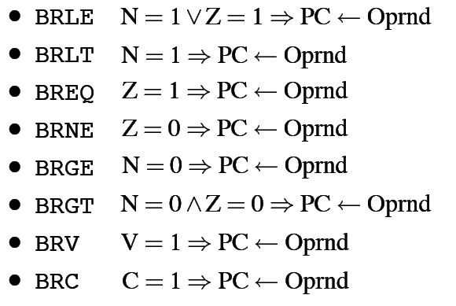
Branching Instructions (Cont’d)
Notes:
Here are the states of the status bits that they will branch on.

Slide 32
Branching
Branches are based on the last operation that changed the status bits
So BRLT checks to see if the last operation that changed the status bits was negative (ie, N = 1)
BRLE checks to see if the last operation that changed the status bits was negative or equal to 0 (ie, N = 1 OR Z = 1)
BRGT checks to see if the last operation that changed the status bits was positive and not equal to 0 (ie, N = 0 AND Z = 0)
Notes:
Six of these branch on the condition of one status bit only.
For example BRLT – Branch on less than – will branch if Negative = 1
i.e. if after a compare (basically a subtract) the result is negative it is less than
Then the branch will be taken.
BRLE – Branch on less than or equal to - will branch if Negative =1 OR Zero = 1
i.e. if after a compare ( basically a subtract) the result is negative it is less than, or if it is zero it is equal to.
Then the branch will be taken.
BRGT – Branch on greater than – will branch if Negative = 0 AND Zero = 0
i.e. if after a compare ( basically a subtract) the result is positive it is greater than, and if it is not zero it is not equal to.
Then the branch will be taken.
You should be able to interpret the action of each of the single status bit branches accordingly.

Slide 33
Branching
If you want to branch, must first perform some operation that affects the status bits.
Example:
LDA num,d
BRLT Place
Note that a LDA will affect the status bits.

Slide 34
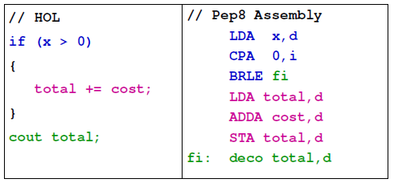
IF Structure Flow and Translation
Note: In this HOL snippet, we test to see if we should enter the block.
In the Assembly translation, we test to see if we should SKIP the block.
Notes:
Here the colors indicate the HOL6 statement and its equivalent instructions in PEP8.
The if statement is accomplished by loading x and comparing to 0.
If it is less that or equal to 0 the statements in pink are branched over just as it is in the HOL6 program.

Slide 35
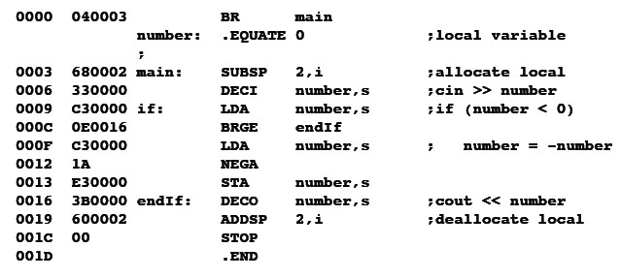
The if statement at Level HOL6 and Level Asmb5
#include <iostream>
Using namespace std;
main(){
int number;
cin >> number;
if (number < 0){
number = -number;
}
cout <<number;
}
Note the inversion!
Notes:
Often the implementation is easier in Assembly if the condition statement is inverted.
Here the C++ program condition statement is if number is less than 0
<click>
In the equivalent Assembly program BRGE is used to branch around the decrement instructions.

Slide 36
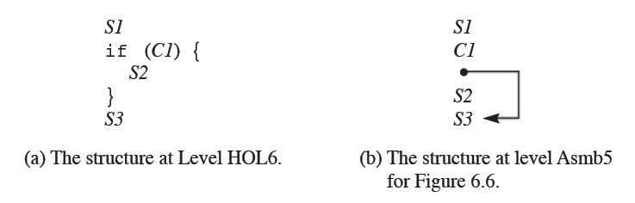
The if statement at Level HOL6 and Level Asmb5
Notes:
This shows the implementation of the if statement.

Slide 37
If statements
To make an if statement at the assembly level work exactly like an if statement at the C++ level must:
Make the condition relative to 0
ie, x > y becomes x - y > 0
Invert the condition.
ie, x - y > 0 becomes x - y <= 0
Notes:
To implement an if statement exactly:
The condition statement must be changed to be relative to 0
And
The condition must be inverted as shown here.

Slide 38
Optimizing Compilers
0000 700005 BR Main
0003 0000 number: .BLOCK 2
;
0005 E90003 Main: DECI number,d ; cin >>number
0008 090003 If: LDA number,d ;if (number < 0)
000B 980018 BRGE EndIf
000E 090003 LDA number,d ;number = -number
0011 38 NOTA
0012 180001 ADDA 1,i
0015 110003 STA number,d
0018 F10003 EndIf: DECO number,d ;printf(“%d”,number)
001B 00 STOP
001C .END
Redundant Instruction!
The value of number will still be in the accumulator from previous load at 0008.
Notes:
Compliers follow an algorithm for translating from a HOL to Assembly. Often the code they produce is not as efficient as it could be due to the algorithm
<click>
Here we see a redundant load command that is not needed because the value of number is still in the accumulator from the previous load.
Some of you did this in your programs in Chapter 5 also!

Slide 39
Optimizing Compilers
Could eliminate the LOADA at address 000E in last program
Optimizing compilers fix this, others don’t
Compiler must:
analyze the previous instructions generated
remember the content of the accumulator
don’t generate a load if value hasn’t changed
Notes:
Optimizing compilers detect these redundancies & fix them.

Slide 40
Optimizing Compilers
OC take longer to compile
If developing software and doing lots of compiles use a non-optimizing compiler
If have a large program that will be used by many users, use an optimizing compiler
Notes:
An Optimizing Compiler will take longer to compile, but if the software needs to be faster or is used by many users it is worthwhile to gain the efficiency.

Slide 41
Compiling
Traditionally, assembly language programs that were generated by a compiler were slower than assembly language programs created by hand.
Not always true now; modern architectures are very complicated
Notes:
In the past assembly language programs generated by a compiler were slower than those codes by hand.
However modern compilers have improved and modern CPU architectures are very complicated. Compilers are designed to use the most efficient instructions and path to implement HOL6 programs.

Slide 42
Compiling
Why use higher-order languages?
Type checking
Structured programming is easier to understand.
Can be more verbose: can say cout>>”my long string”
The biggest cost in software development is the programmers!
Notes:
I don’t think I have to convince you that programming is easier in HOL languages.
Today, with fast CPUs and inexpensive memory, the biggest cost is the programmers.
It is advantageous to write and maintain programs in HOL 6 languages because the programmers are more efficient.

Slide 43
CPR instruction
CPr is identical to SUBr except
SUBr stores result in R register
CPr does not store result anywhere.
Both instructions affect the NZVC bits.
Notes:
As discussed before the Compare instruction is a Subtract instruction that sets the status bits but does not store the result.
It is very useful for implementing condition statements.

Slide 44
The if/else statement at Level HOL6 and Level Asmb5 - Program 6.2 (fig. 6.8)
#include <iostream>
Using namespace std;
int main( ) {
const int limit = 100;
int num;
cin >> num)
if (num >= limit) {
cout << “high”;
}
else {
cout << “low”;
}
return 0;
}
Notes:
Here is the C++ program using an if/else statement – Fig 6.8 from the text book.

Slide 45
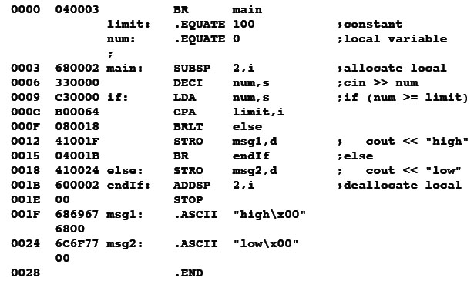
The if/else statement at Level HOL6 and Level Asmb5 - Program 6.8
simplify and invert
branch around else
branch on the inverted condition
Notes:
Here the conditional num >= limit is implemented
<click>
First by loading num and comparing it to limit.
<click>
Then Branch on Less than which branches around the string output of high to the location else and outputs low.
<click>
Note that after the string output of high an unconditional branch must be implemented to branch around the output of low.

Slide 46
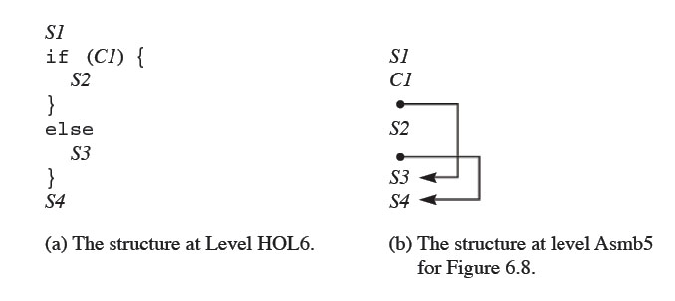
The if/else statement at Level HOL6 and Level Asmb5 (Cont’d)
Notes:
This shows the implementation of the if/else statement.

Slide 47
The while statement at Level HOL6 and Level Asmb5 (fig. 6.10)
#include <iostream>
Using namespace std;
char letter;
main( ) {
cin >> letter;
while (letter != ‘*’)
{
cout << letter;
cin >> letter;
}
return 0;
}
Notes:
Here is a C++ program using a while statement- Fig 6.10 from the text book.

Slide 48
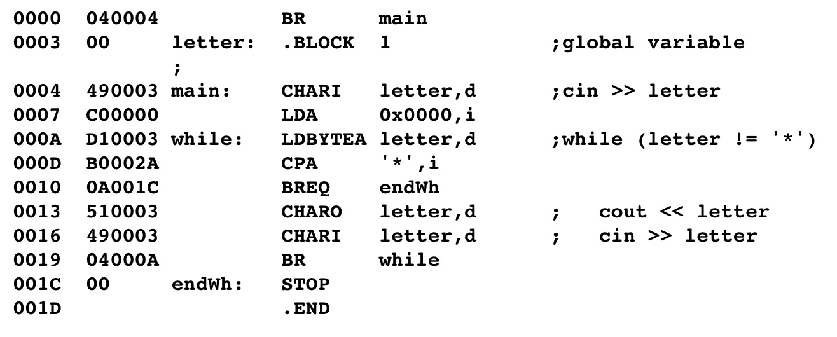
The while statement at Level HOL6 and Level Asmb5
Clear accumulator. Why?
Simplify condition:
letter – ‘*’ != 0
Test inverse condition
Jump out of loop when
letter – ‘*’== 0
Unconditional jump to top
of loop to test condition again
Notes:
Let’s look at this implementation
<click>
First the Accumulator is cleared – Do you know why?
The compare instruction looks at both bytes in the accumulator and since characters load in the right most – or least significant byte, we must assure that the left or most significant byte is set to 00 hex.
<click>
Again the condition is changed to be based on 0
Letter - * != 0
<click>
The letter is loaded and compared to *
If the result is zero – they are equal and the Branch is taken to the endWH location.
<click>
If the result is not zero the character is output and an other character is input and an unconditional branch goes back to the while location to beginthe test again

Slide 49
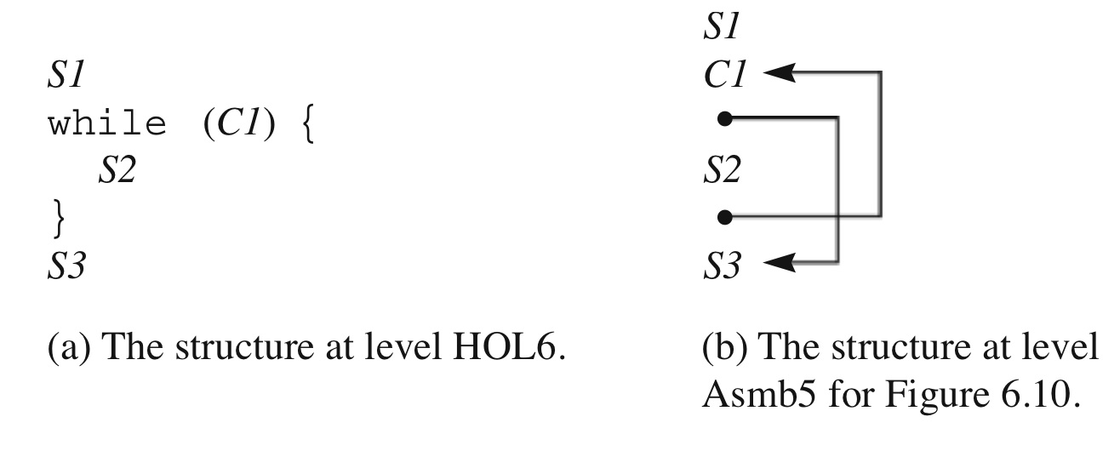
The while statement at Level HOL6 and Level Asmb5
Notes:
This shows the implementation of the while statement.

Slide 50
The do statement at Level HOL6 and Level Asmb5 (Fig. 6.12)
#include <iostream>
using namespace std;
int cop;
int driver;
main( ) {
cop = 0;
driver = 40;
do {
cop += 25;
driver += 20;
} while (cop < driver);
cout << cop;
}
Notes:
Here is a C++ program using a while statement- Fig 6.12 from the text book.

Slide 51
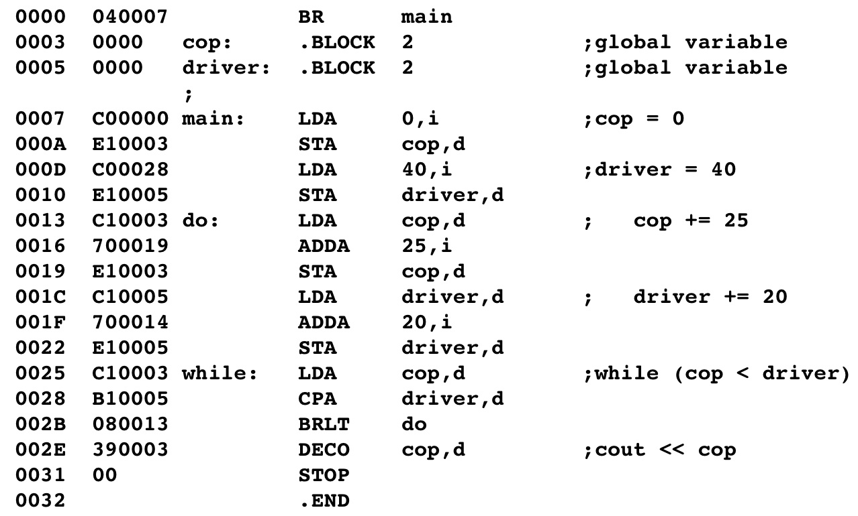
The do statement at Level HOL6 and Level Asmb5 (Fig. 6.12)
Simplify:
cop - driver < 0
Test the same condition
Do not transform
Why?
Notes:
This is the Assembly equivalent.
<click>
Here the condition is simplified to cop-driver <0
<click>
However the condition is not inverted – Do you know why?
The condition for do is checked at the end of the loop not at the beginning.

Slide 52
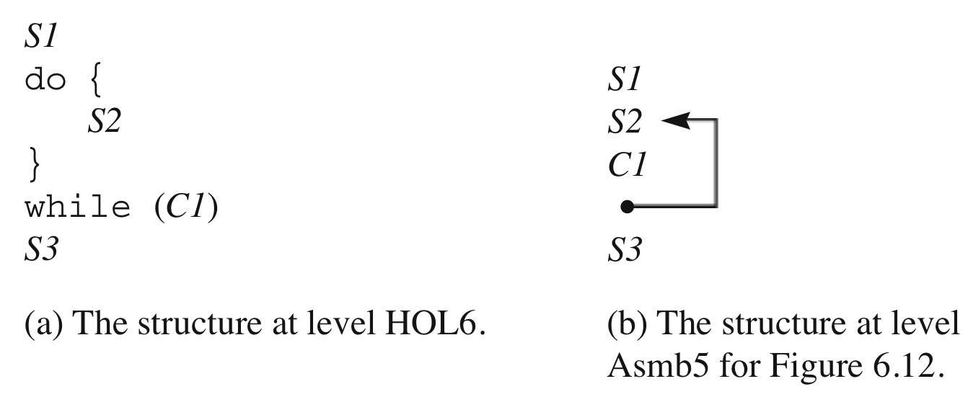
The do structure
Notes:
This shows the implementation of the do statement.

Slide 53
The for statement at Level HOL6 and Level Asmb5 (Fig. 6.14)
#include <iostream>
using namespace std;
main ( ) {
int j;
for (j = 0; j < 3; i++)
{
cout << “j = “ << j << endl;
}
cout << “j = “ << j << endl;
return 0;
}
Notes:
Here is a C++ program using a for statement- Fig 6.14 from the text book.

Slide 54
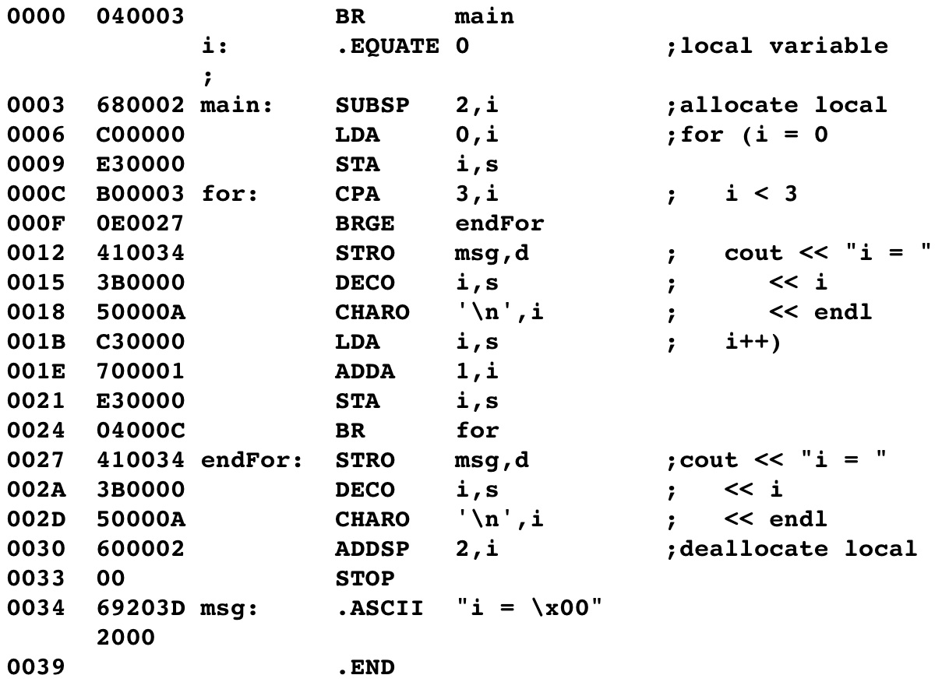
The for statement at Level HOL6 and Level Asmb5
initialization
test
Branch on simplified inverse condition
increment
branch to top of loop
Notes:
This is the Assembly equivalent.
<click>
The variable I is loaded and stored.
<click>
It is compared to 3
<click>
and branch is greater than or equal to.
<click>
I is incremented and stored
<click>
and an unconditional branch returns to the beginning of the loop at the for location.

Slide 55
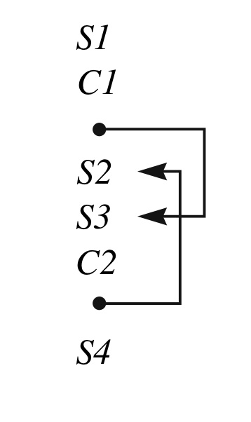
The structure of the for
Notes:
This shows the implementation of the for statement.

Slide 56
Multiple Conditions
Often necessary to have multiple conditions in a control statement
#include <iostream>
using namespace std;
int num1, num2;
main ( ){
cin >> num1, num2;
if ((num1 > 0) && (num2 > 0))
cout << “Positive”;
else
cout << “Negative”;
}
Notes:
Many times multiple conditions are needed to control the flow of the program.
Here two numbers need to be greater than zero.

Slide 57
Multiple Conditions
0000 040007 BR main`
0003 0000 num1: .BLOCK 2
0005 0000 num2: .BLOCK 2
0007 310003 main: DECI num1,d ;cin >>num1,num2)
000A 310005 DECI num2,d
000D C10003 LDA num1,d ;num1 > 0
0010 06001F BRLE else
0013 C10005 test2: LDA num2,d ; num2 > 0
0016 06001F BRLE else
0019 410023 STRO pos,d ; the if body
001C 040022 BR done
001F 41002C else: STRO neg,d ; the else body
0022 done: STOP
0023 .ASCII "Positive\00"
002C .ASCII "Negative\00"
0023 .END
Notes:
Here two branch statements are put in series to get the desired results.

Slide 58
Multiple Conditions
Often necessary to have multiple conditions in a control statement
#include <iostream>
using namespace std;
int num1, num2;
main ( ){
cin >> num1,num2;
if ((num1 > 0) || (num2 > 0))
cout << “P”;
else
cout << “N”;
}
Notes:
Here the AND is changed to an OR in the condition statement.

Slide 59
Multiple Conditions
0000 040007 BR main
0003 0000 num1: .BLOCK 2
0005 0000 num2: .BLOCK 2
0007 310003 main: DECI num1,d ; cin >> num1,num2)
000A 310005 DECI num2,d
000D C10003 LDA num1,d ;num1 > 0
0010 10001F BRGT if
0013 C10005 test2: LDA num2,d ; num2 > 0
0016 10001F BRGT if
0019 41002C STRO neg,d ; the else body
001C 040022 BR done
001F 410023 if: STRO pos,d ; the if body
0022 done: STOP
0023 .ASCII "Positive\00"
002C .ASCII "Negative\00"
0023 .END
Notes:
The two branch statements in series can be change to get the desired results.

Slide 60
Other control structures
At assembly level can write control structures that do not correspond to any high level control structure.
See Mystery Program

Slide 61
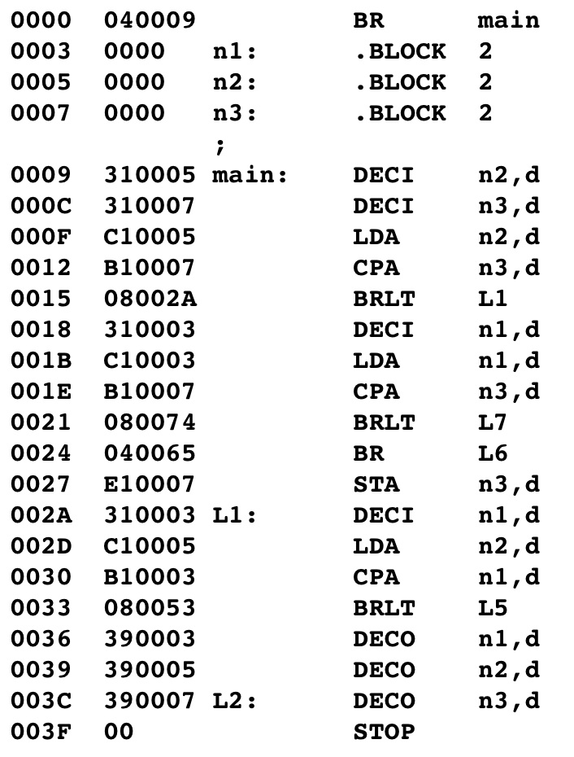
A mystery program
Notes:
This logic of this program is difficult to follow because of the multiple conditional branch statements.

Slide 62
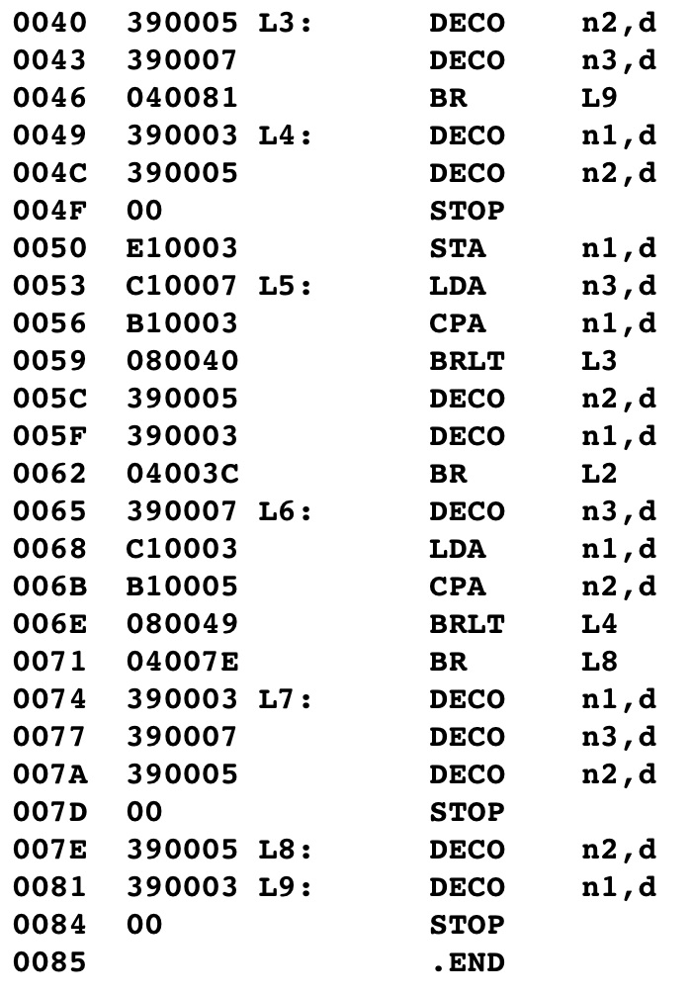
A mystery program(cont)

Slide 63
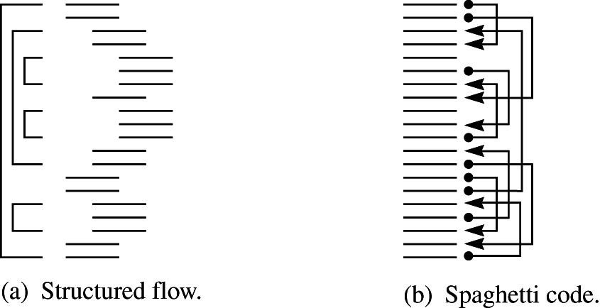
A mystery program (Cont’d)
Notes:
Structured programs can be mapped like the diagram on the left. You may have done this with HOL6 programs in the past to determine their flow.
The mystery program map looks like the diagram on the right and is called spaghetti code. It may be more efficient in that it runs faster and requires less memory than the program on the left. However, it is hard to understand and to modify.

Slide 64
Structured vs. Unstructured Flow
Assembly Language has unstructured flow
Possible to jump to any point in memory
Can jump into/out of the middle of loops
Old HOL (pre-1970’s) has GOTO command
Modern HOL has structured flow of control
Every structure has a start and end
Can only jump to a start or end point
Notes:
Assembly language allows unstructured flow.
Old HOL languages such as FORTAN had GOTO commands that also allowed unstructured flow.
Modern HOL languages usually have structured flow because they do not have GOTOs that allow jumping, however a programmer can over use nested if statements and while statements that unnecessarily complicate the program.

Slide 65
Structured Programming Theorem
Any algorithm containing goto’s can be written with only nested if statements and while loops
Proven mathematically by Corrado Bohm and Guiseppe Jacopini in 1960
Notes:
Bohm & Jacopini proved that any algorithm containing goto’s can be written with only nested if statements and while loops.

Slide 66
The Goto controversy
Two years after the Bohm/Jacopini paper, Edsger W. Dijkstra of the Technological University at Eindhoven, the Netherlands, wrote a letter to the editor of the same journal.
He stated his personal observation that good programmers used fewer goto’s than poor programmers.
Proposed that goto’s be abolished from all “higher level” programming languages.
Notes:
Djkstra proposed that GOTO’s be eliminated from HOL programming languages.

Slide 67
The Goto controversy
Large controversy followed.
It is now recognized that Dijkstra was correct.
Reason
Cost. Less expensive to develop, debug, and maintain code without goto’s.
Note that an absence of gotos will not guaranteed well structured code.
Notes:
These two papers posted on blackboard and are the topic of this week’s discussion question.

Slide 68
6.3 Procedure and Function Calls
Learning Objectives
Describe assembly- & machine- level operations needed to CALL and RETURN from a function
Show how to pass parameters to a function
Show how to return a value from a function
Notes:
Finally – on to Procedure and function calls
In this section, we will learn the two instructions to needed to CALL to & RETURN from a function.
We will learn how to pass parameters to a function and how to return a value from a function.

Slide 69
Function Calls and Parameters
C++ function call changes the flow of control
Must jump to the first instruction in the function
When function finishes, must return to the instruction that follows the function call
Notes:
A function call changes the flow of control.
It causes the program to jump to the function and then to return to where it was called from.

Slide 70
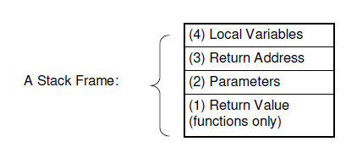
Function Calls and Parameters
Functions make a round-trip change of instruction flow:
Call
Return
Functions use the stack for temporary data storage
Notes:
As we learned in Chapter 2 the function call creates a stack frame on the run-time stack.

Slide 71
Subroutines
Function calls in assembly language are called subroutines
Two Assembly instructions to enable a subroutine:
CALL, jump to subroutine
RETn, return from subroutine
Both assume immediate addressing
Notes:
Function or procedure calls in assembly language are called subroutines.
The two instructions are CALL & RETn – both assume immediate addressing.

Slide 72
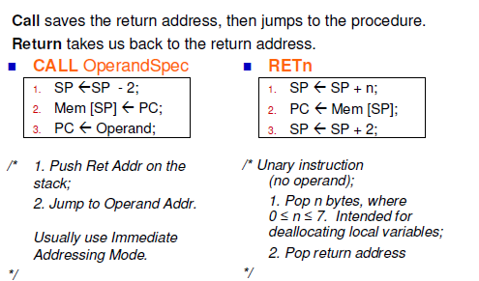
Subroutines
Notes:
Here are the RTL for these instructions.
You can see that both manipulate the Program Counter register and the Stack Pointe register.

Slide 73
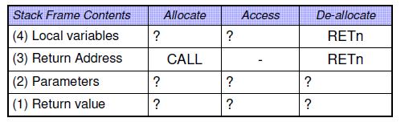
Creating and Accessing a Stack Frame
CALL & RETn do only part of the work needed for pushing and popping stack frame items
How do we do the rest?
We’ll try to answer this gradually.
Notes:
CALL & RETn only do part of the work – we will doo the rest.
Let’s look at it closer.

Slide 74
CALL
Pushes the content of the PC onto the runtime stack
Loads the operand into the PC
SP = SP – 2;
// place return addr on RT stack
Mem[SP] = PC;
// jump
PC = Oprnd;
Notes:
CALL pushes the PC on the stack so the return address is captured.
Then is loads the operand – the symbol name for the subroutine - into the PC

Slide 75
CALL
CALL depends on the von Neumann execution cycle (fetch, increment, decode, execute, repeat).
The three instructions on previous slide done in the execution part of the cycle.
Since increment PC before execute, the return address that is saved is the address of the instruction following the CALL.
Notes:
Again, the order of the von Neumann execution cycle is important for the return address to point to the correct location.

Slide 76
RETn
Return from subroutine
n is the number of local variables
There are 8 versions of RETn:
RET0, RET1, RET2, … RET7
Where n is the number of bytes occupied by the local variables in the subroutine
Unary instruction
Notes:
RETn – contains the number of local variables in the subroutine.
It is a unary instruction. If you recall this means that it does not have an Operand Specifier.

Slide 77
RETn
Operation:
First, the instruction deallocates storage for the local variables by adding n to the SP
Then, instruction moves the return address from the top of the stack into the PC
Finally, instruction adds 2 to the SP to complete the pop operation.
If there are more than 7 bytes of local variables, compiler will add ADDSP instruction to deallocate the rest of the locals.
Notes:
RETn will deallocate the storage for the local variables by adding to the SP.
If there are more than 7 bytes of local variables an additional instruction will be added.
Then move the return address from the stack to the PC and adds 2 to the SP.

Slide 78
RETn
Operation:
SP = SP + n;
PC = Mem[SP]; // get return addr
SP = SP + 2; // pop stack
Notes:
Here is its operations.

Slide 79
A procedure call at Level HOL6 and Level Asmb5 (Fig 6.18)
#include <iostream>
Using namespace std;
Void printTri( ) {
cout << “*” << endl;
cout << “**” << endl;
cout << “***” << endl;
}
Int main ( ) {
printTri( );
printTri( );
printTri( );
return 0;
}
Notes:
Here is a C++ program with a procedure call - Fig 6.18 from the text book.

Slide 80
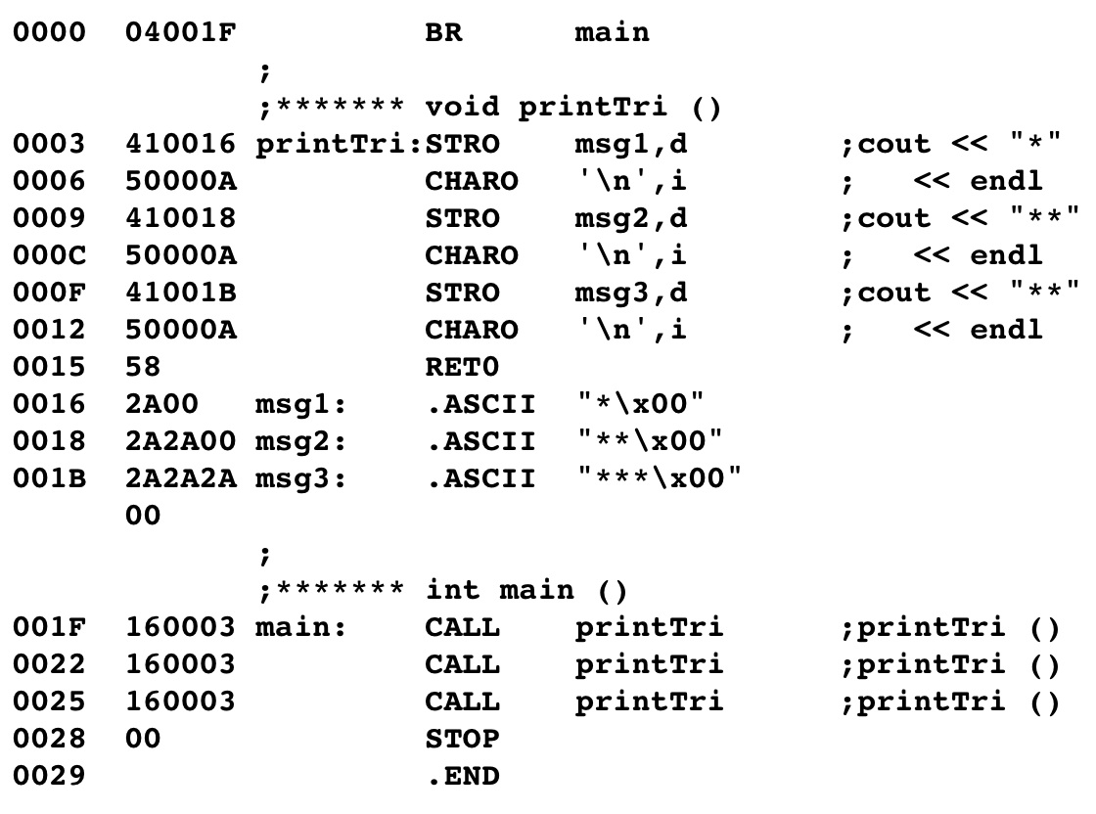
A procedure call at Level HOL6 and Level Asmb5
address of the subroutine
RET0 uses the address on the stack
0 because there are no local variables
Notes:
Here is its Assembly Language equivalent
<click>
The symbol printTri marks the address of the first statement in the subroutine.
RET0 pops the return address off the stack and places it back into the PC

Slide 81
A procedure call at Level HOL6 and Level Asmb5
Pushes address 0022 onto stack
puts address 0003 into PC
PC
SP
0022
User Stack
0022
0003
FBCF
FBCD
after execution of CALL
Before execution of CALL
Notes:
<click>
When the first call to printTri occurs the return address 0022 – the next statement - is pushed on the stack, and address 0003 – the address of printTri – is put into the PC.
Each successive call will use the same location 0003 to go to printTri, but will push a different return address on the stack.

Slide 82
A procedure call with a parameter at Level HOL6 and Level Asmb5
Convention for calling a subroutine:
Push storage for the return value(if exists)
Push the actual parameters
Push the return address
Push storage for the local variables
Notes:
Here is the convention for the order of storage for calling a subroutine.
This is the same order that we learned in Chapter 2 for C++.

Slide 83
Subroutines
An assembly program must contain explicit instructions to manipulate the run time stack.
Calling program
pushes the actual parameters and
executes the CALL (pushes the return address)
The called program
allocates stack space for local variables.
Notes:
In C++, the stack was taken care of and transparent to your program.
In Assembly language, there must be explicit instructions to manipulate the run-time stack.
The Calling program pushes the actual parameters and executes the CALL
The Called program allocates stack space for local variables.

Slide 84
Subroutines
The called program
deallocates stack space of local variables and pops the return address by executing RETn.
The calling program
deallocates storage of actual parameters.
Notes:
At the end of the subroutine,
The Called program deallocates space for local variables on the stack and executes RETn.
The Calling program deallocates the storage of the prarmeters.

Slide 85
Summary
Calling pushes actual parameters ( executes SUBSP)
Calling pushes return address (executes CALL)
Called allocates local variables (executes SUBSP)
Called executes its body
Called deallocates local variables and pops local variables (executes RETn, maybe ADDSP)
Calling pops actual parameters (executes ADDSP)
Notes:
Here is the whole sequence

Slide 86
Summary
Recall: The Return value is on the bottom of the stack frame
Calling procedure allocates stack space
Shifts the stack point up (negative)
Called procedure will store its result there
Both procedures will access it,
but may have different stack offsets
Notes:
If there is a return value,
The Calling program allocates stack space for it first.
The Called program will store its value there.
Both procedures access it with stack relative addressing, however the offset may be different.
Please review the other lectures on Pass by Value, Pass by Reference and Boolean Types before taking the quiz.

